Slide 1
Massey University School of Aviation
Damen Golding - IAOPA World Assembly 2018
Notes:
Massey University RPAS Team – introduction

Slide 2
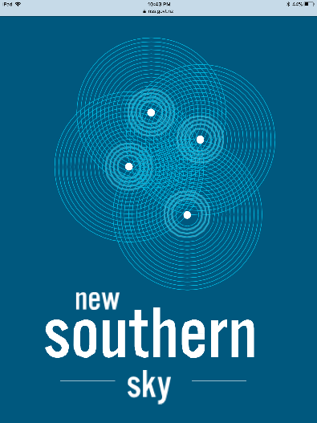
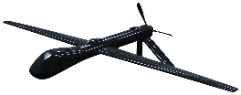
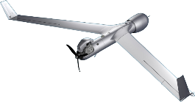
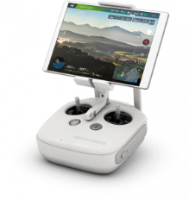
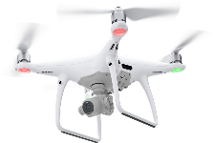
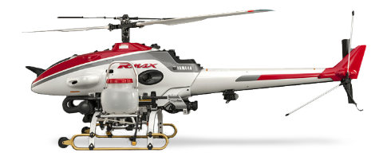
Comms
VOIP
Surveillance
ADS-B
Navigation
IFR
RNAV1/2
RNP1/2
Digital Information
WXXM
RPAS Pilots
Notes:
What does the furtre of drone integration into the NAS look like. 2023 Concept f operations from NSS (New Southern Sky is the name for the implementation phase of the National Airspace and Air Navigation Plan)

Slide 3
The Challenges we face
Non-aviators
Unaware of risks & consequences of their operations
Notes:
We have identified 4 main challenges with intergrating drones into our airspace.
2nd point (ie potential mid air, already occurring delays/missed approaches etc NATS slide)
Sharing airspace with a changing industry – hard to manage. Funding etc, someone has to pay for all the changes required to sustain it.

Slide 5
The Challenges we face
Non-aviators
Unaware of risks & consequences of their operations
Is it really common sense?
Industry is changing faster than we can regulate/educate it
Notes:
Sharing airspace with a changing industry – hard to manage. Funding etc, someone has to pay for all the changes required to sustain it.

Slide 6
Massey University’s Role
Responsibility to educate along side with the CAA.
Promote the shared airspace user concept
Notes:
1 – As I said Our primary role is education and our number 1 pritority is safety. Rules are jargon to a non aviator, we Train them in an aviation environment – learn about airmanship and about the threats they should look out for as well as the threat the pose to others. B/C-Cat instructors.
2 - (use sams notes from UAV conference)

Slide 7
What do we do?
Primarily Course Delivery & Flight Testing
Developing RPAS Procedures & Courses
FRTO RPAS Rating Submission
RPAS Policy for Massey University
1 Day Theory Course
5 Module School Course
RPAS Operations
Foxpine Operation
RPAS Research
For Masters/PhD and integration into BAv Man papers
Transponders fitted to UAS

Slide 8
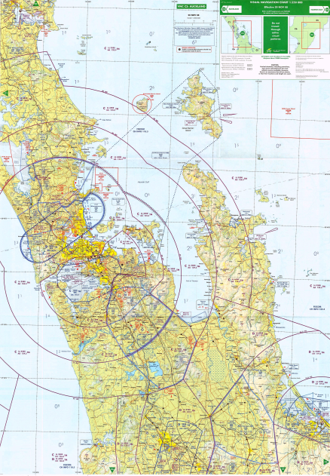
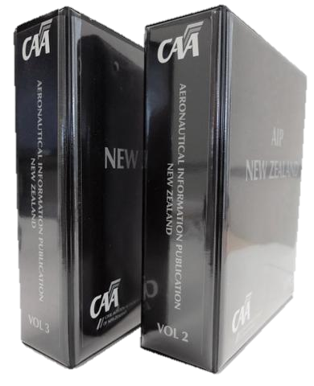
Course Objectives
Interpret the various aviation regulations and be able to apply these to operations. CAA Rule Part 101 & 102 Guidance.
Interpret the various aviation documents and be able to use these operationally. AIP’s and VNC’s.
Practice and comprehend radio telephony procedures (Flight Radio).
In general, how to display airmanship and operate safely just like any pilot or airspace user.

Slide 9
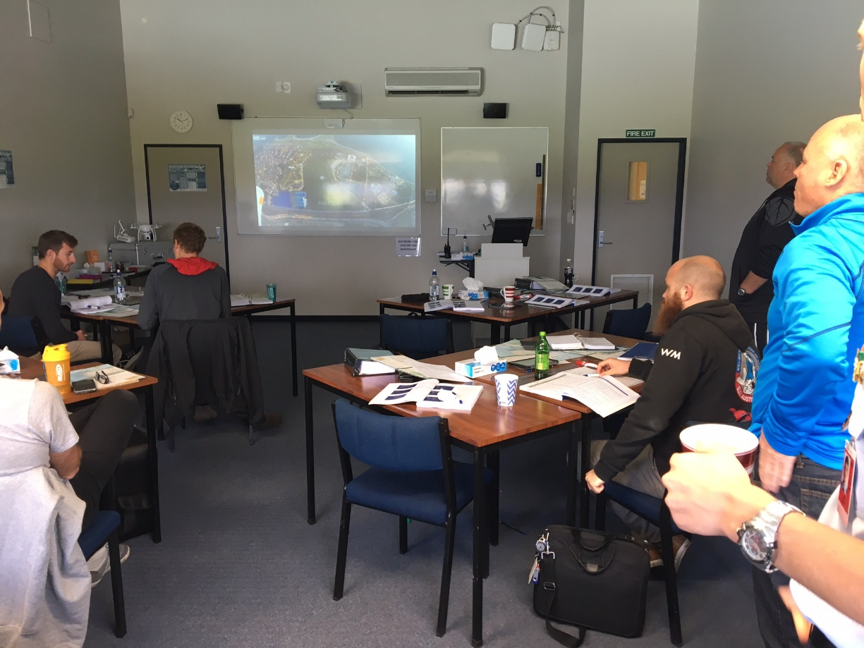
RPAS Course Delivery
Total Courses: 50
Total Course Attendees: 484
Total Wings Badges: 331
2017 Courses: 28
2017 Attendees: 335
2017 Wings Badges: 221

Slide 10
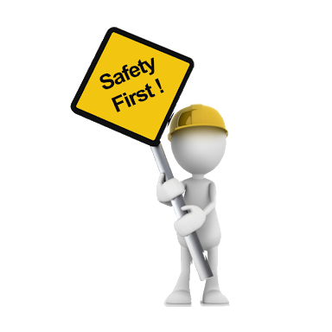
Goals moving forward
What should we work towards
Maximising safety for the whole industry
No decreased access to either RPAs or manned aircraft – Shared airspace user
Increase operating standards for RPAS users. Scalable to operations.
Notes:
, i.e. background checks, currency etc.

Slide 11
Safer Operations – Reap the Rewards
Damen Golding – d.golding@massey.ac.nz

